Slide 1
Project 2: Final Presentation
Kayla Robledo
March 30th, 2026

Slide 2
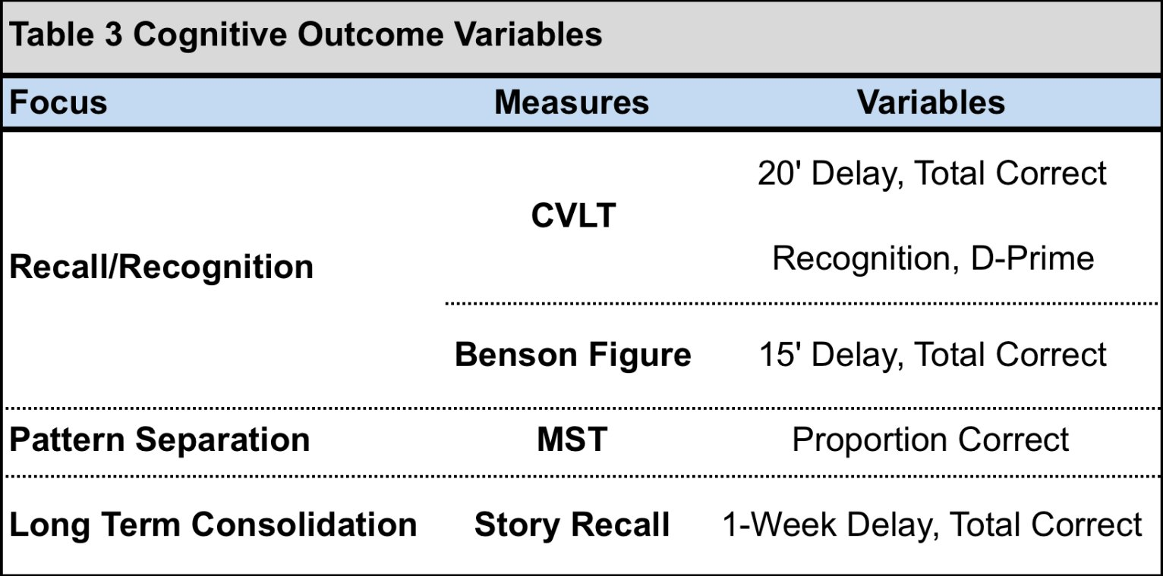
Hypotheses
1a. Higher baseline inflammation levels are associated with decreases in cortical thickness and memory consolidation after 1 year.
1b. Increases in the change of inflammation levels from baseline to 1 year follow-up are associated with declines in episodic memory and cortical thickness after 1 year.
2. Higher levels of both amyloid deposition and inflammation are associated with decreases in memory and cortical thickness after 1 year.

Slide 3
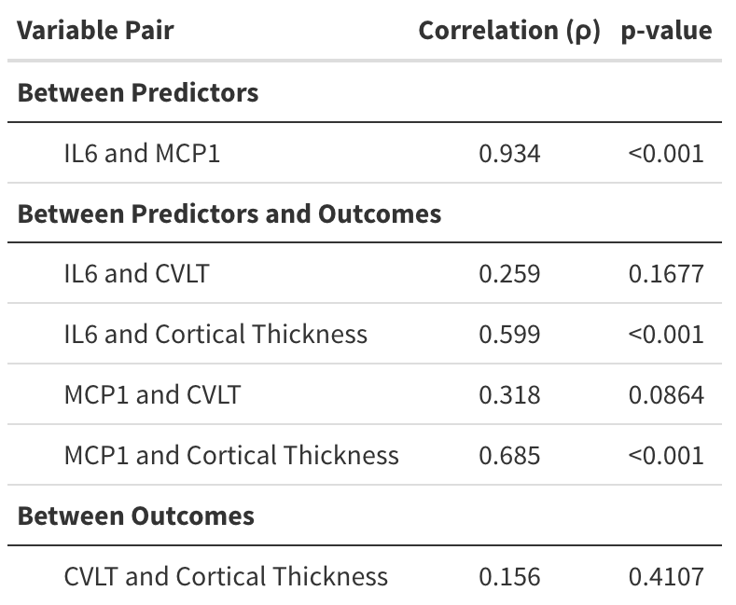
Preliminary Data
Takeaways:
Inflammation markers are highly correlated
Outcomes are modestly correlated
Correlations between inflammation markers and outcomes ranges from 0.2 to 0.7

Slide 4
Analysis Plan
Inflammation markers are cytokine (IL-6, TNF-α) and chemokine (MCP-1, Eotaxin-1)
Aim 1:
Hypothesis 1a.
24 general linear models
6 outcomes: 5 memory measures and cortical thickness
4 primary explanatory variables: Baseline inflammation markers
Covariates: Baseline outcome, age, sex, other as necessary
Cardiovascular risk, autoimmune diseases, APOE genotypes, and other health measures
Type-I error correction: Bonferroni-like where α = 0.05/4, 0.05/6, and 0.05/24
Look for consistency and direction of findings to determine threshold
Hypothesis 1b.
4 primary explanatory variables: Change in inflammation markers after 1 year
Aim 2:
4 primary explanatory variables: Interaction between change in inflammation markers and amyloid deposition after 1 year
Additional covariate: Change in amyloid deposition after 1 year
Power Assumptions:
175 total participants
Correlations range from 0.2 to 0.7 and are always positive
Amyloid deposition is a categorical variable, and the correlation is higher in the positive group
Same type-I error corrections
Optimal power is 80%

Slide 5
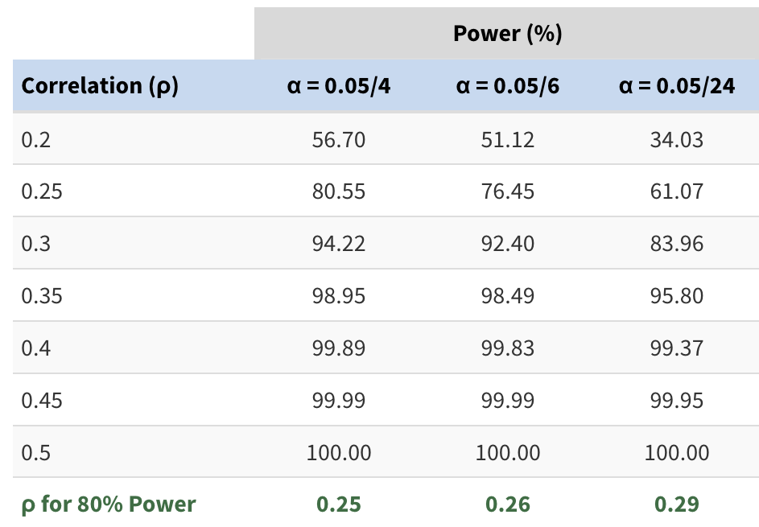
Aim 1 Power Calculation
Takeaways:
As correlation increases, power increases
To achieve at least 80% power:
Least conservative: correlation of 0.25 is needed
Conservative: correlation of 0.26 is needed
Most conservative: correlation of 0.29 is needed

Slide 6
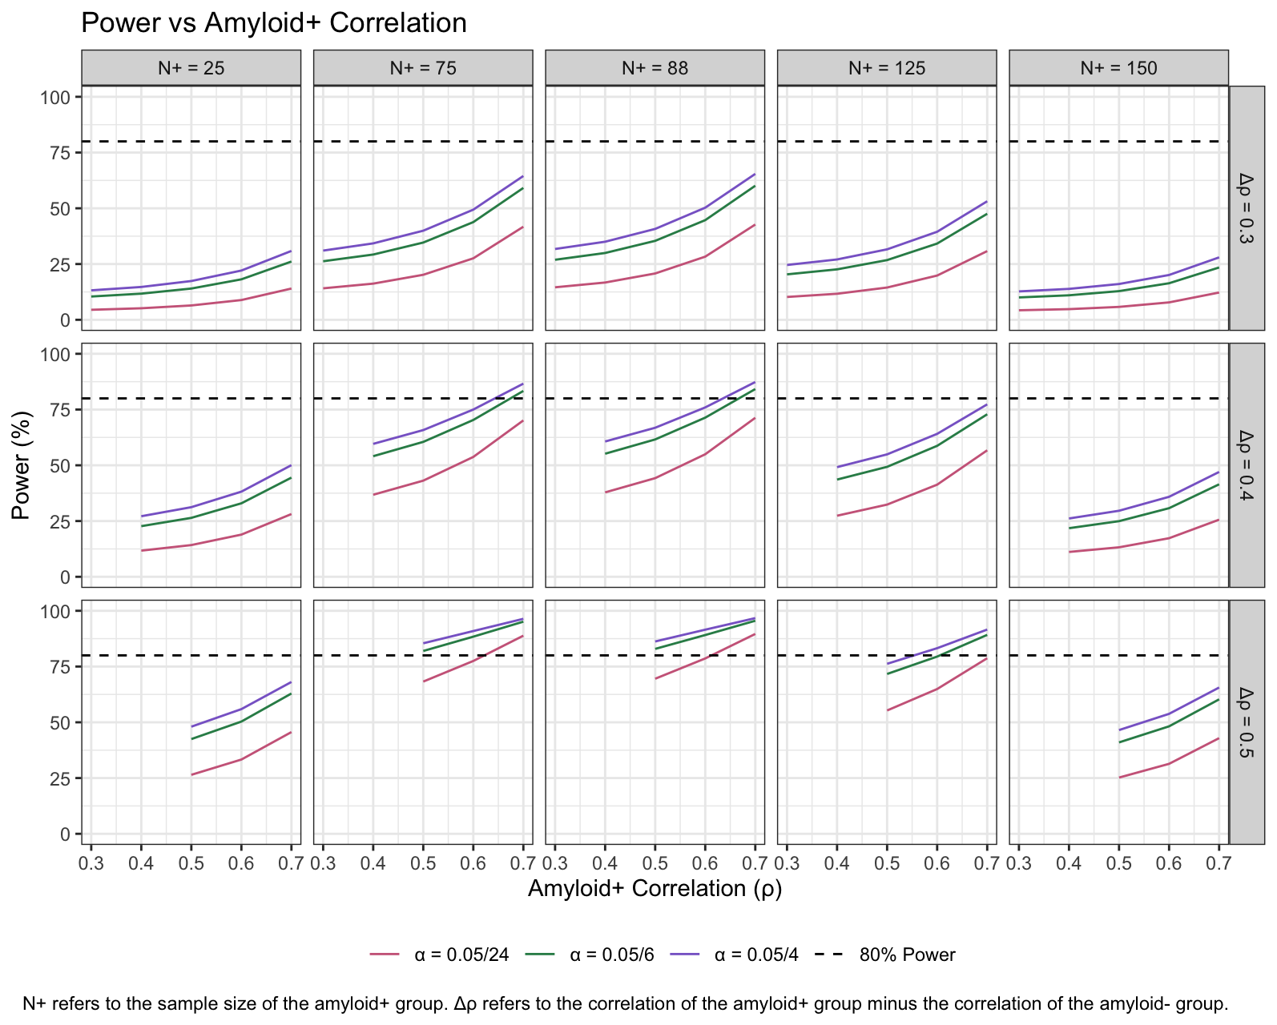
Aim 2 Power Calculation

Slide 7
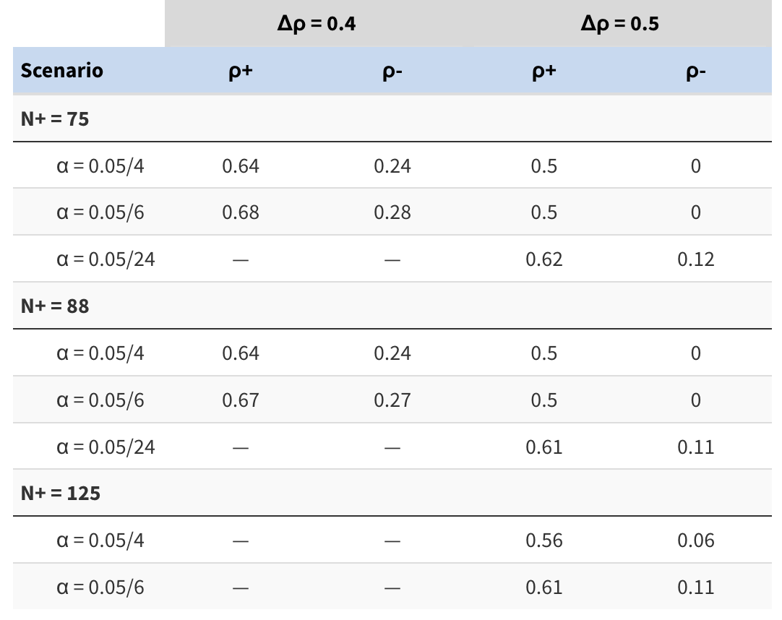
Aim 2 Power Calculation
Takeaways:
Even group sizes require slightly lower correlations and are higher powered
Higher amyloid+ group sample size require slightly larger correlations
To achieve at least 80% power:
A difference in group correlations of 0.4 and beyond are needed

Slide 8
Questions?

